Slide 1
Book Recommendation System
Group - 5
1.Manish Shantaram Mohite
2.Sanjiwani Keshao Wadhave
3.Chakrapani A. M.
4.Apurva Anil Ghodeswar
5.Zambare Linay Prashant
6.Yash Ramchandra Bhosale

Slide 2
Business Objective:
Generate the features from the dataset and use them to recommend the books accordingly to the users.
What Is Recommendation System?
A recommendation system is a subclass of Information filtering Systems that seeks to predict the rating or the preference a user might give to an item. In simple words, it is an algorithm that suggests relevant items to users.
E.g.: In the case of Netflix which movie to watch, In the case of e-commerce which product to buy, or In the case of kindle which book to read, etc.

Slide 3
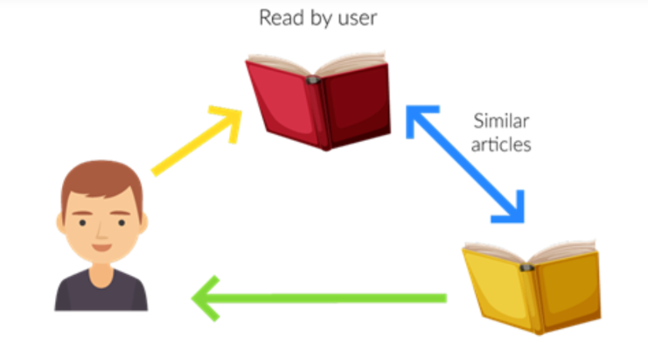
TYPES OF RECOMMENDATION SYSTEM
1. Content-Based Filtering:
In this type of recommendation system, relevant items are shown using the content of the previously searched items by the users. Here content refers to the attribute/tag of the product that the user like. In this type of system, products are tagged using certain keywords, then the system tries to understand what the user wants and it looks in its database and finally tries to recommend different products that the user wants.
Advantage
Model doesn’t need data of other users since recommendations are specific to a single user.
It makes it easier to scale to a large number of users.
The model can Capture the specific Interests of the user and can recommend items that very few other users are interested in.
Disadvantage
Feature representation of items is hand-engineered to some extent, this tech requires a lot of domain knowledge.
The model can only make recommendations based on the existing interest of a user. In other words, the model has limited ability to expand on the user’s existing interests.

Slide 4
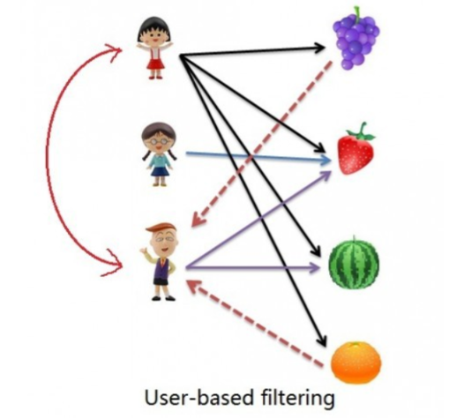
2. Collaborative Based Filtering: Recommending the new items to users based on the interest and preference of other similar users is basically collaborative-based filtering. For e.g.:- When we shop on Amazon it recommends new products saying “Customer who brought this also brought” A. User-Based Collaborative Filtering
TYPES OF RECOMMENDATION SYSTEM
Rating of the item is done using the rating of neighboring users. In simple words, It is based on the notion of users’ similarity.
Let see an example. On the left side, you can see a picture where 3 children named A, B, C, and 4 fruits i.e., grapes, strawberry, watermelon, and orange respectively.
Based on the image let assume A purchased all 4 fruits, B purchased only strawberry and C purchased strawberry as well as watermelon. Here A & C are similar kinds of users because of this C will be recommended Grapes and Orange as shown in dotted line.

Slide 5
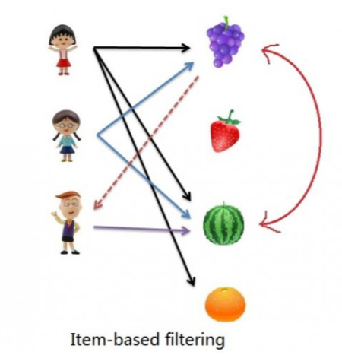
TYPES OF RECOMMENDATION SYSTEM
2. Collaborative Based Filtering:
A. User-Based Collaborative Filtering
The rating of the item is predicted using the user’s own rating on neighbouring items. In simple words, it is based on the notion of item similarity.
Let us see with an example as told above about users and items. Here the only difference is that we see similar items, not similar users like if you see grapes and watermelon you will realize that watermelon is purchased by all of them but grapes are purchased by Children A & B. Hence Children C is being recommended grapes.
Now after understanding both of them you may be wondering which to use when. Here is the solution if No. of items is greater than No. of users go with user-based collaborative filtering as it will reduce the computation power and If No. of users is greater than No. of items go with item-based collaborative filtering. For Example, Amazon has lakhs of items to sell but has billions of customers. Hence Amazon uses item-based collaborative filtering because of less no. of products as compared to its customers.

Slide 6
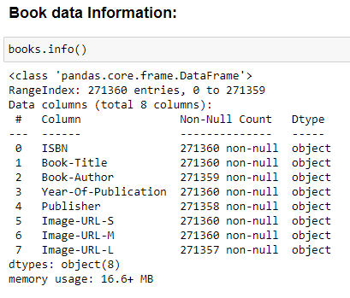
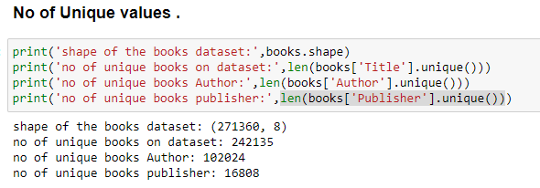
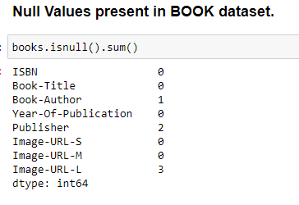
Book Dataset
Since the null values are very less we can drop that null values

Slide 7
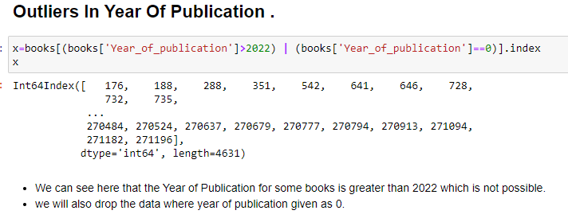
Book Dataset
We will drop this indexes from book data set as the year of publication for this books are ahead of current date.

Slide 8
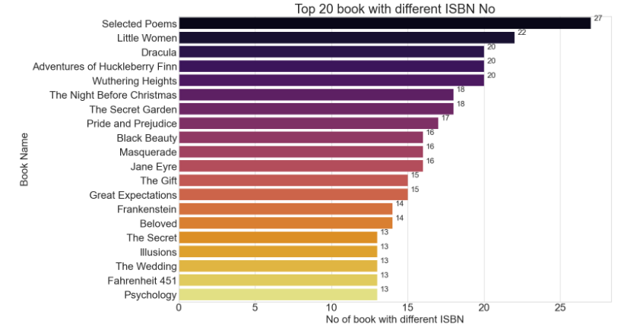
Top 20 books with highest isbn no

Slide 9
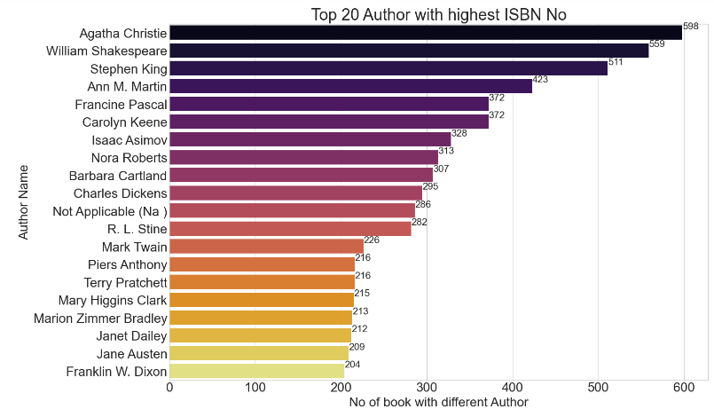
Top 20 author with highest isbn no

Slide 10
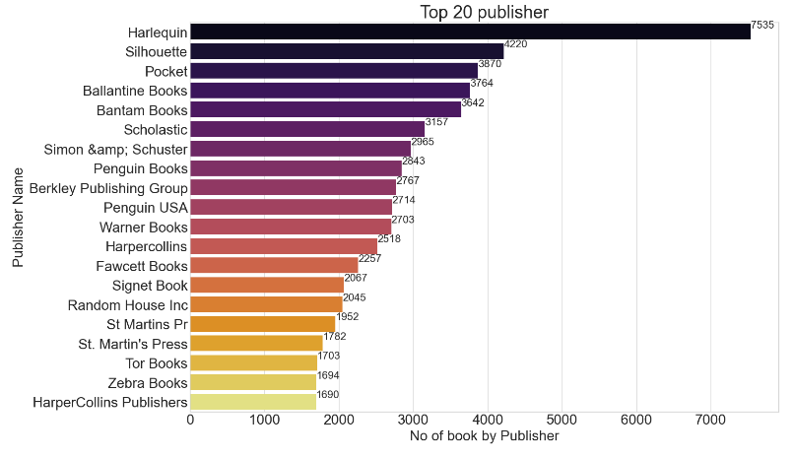
Top 20 Book publisher

Slide 11
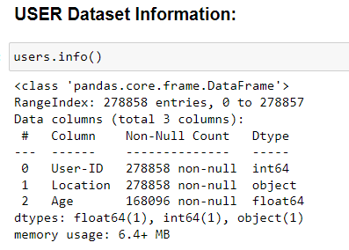
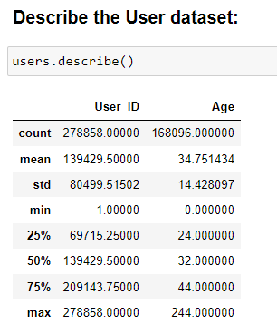
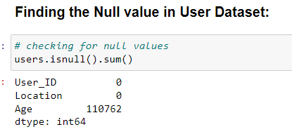
USER Dataset

Slide 12
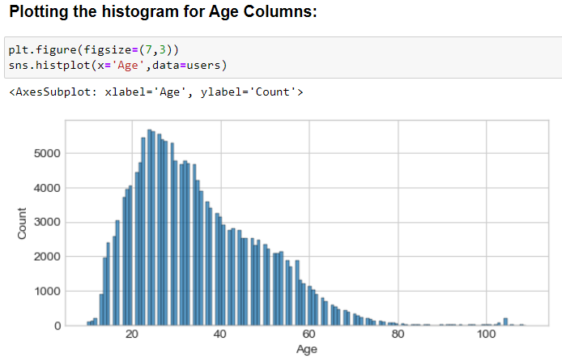
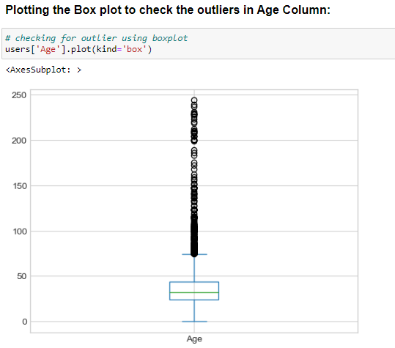
Checking for Outliers in Age
we will drop the data having age more than 110 year also we will drop the year having age below 10 year

Slide 13
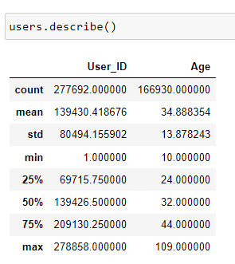
Comparison after removing the outliers from the dataset

Slide 14
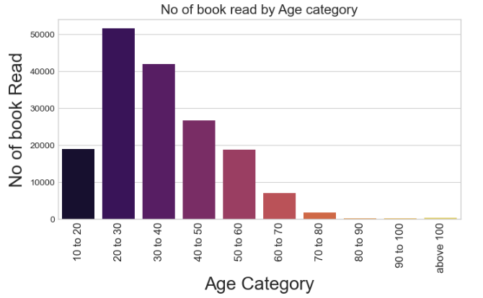
Book read and rated by each age category
the people in between 20 to 40 year age read more books

Slide 15
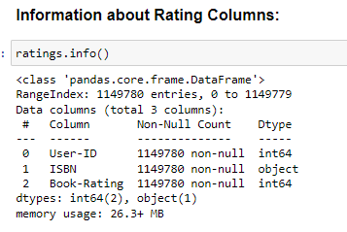
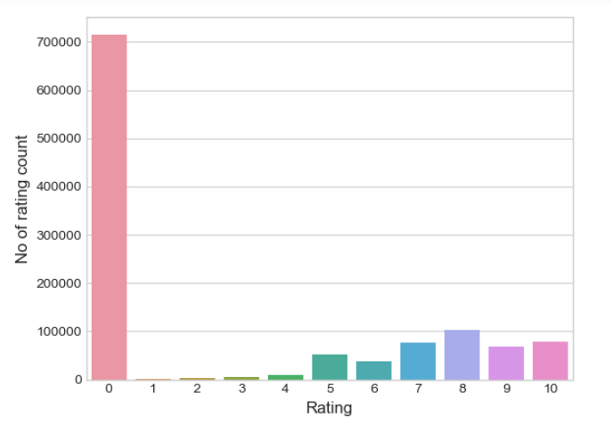
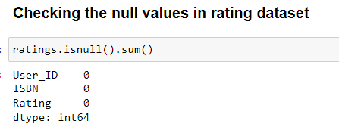
rating Dataset
We can see that zero rating column has higher value count, this is because may be some users have read the books but rating not given for those books.

Slide 16
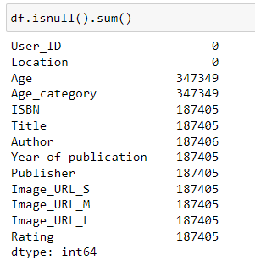
Master Data preparation
After merging the dataset we got some null values, this is due to some of the books not read or rated by the users, also some book having the different ISBN NO so while merging that data we got null values.
Since we can see in dataset, from ISBN to rating columns we have null values, we will drop that null values.

Slide 17
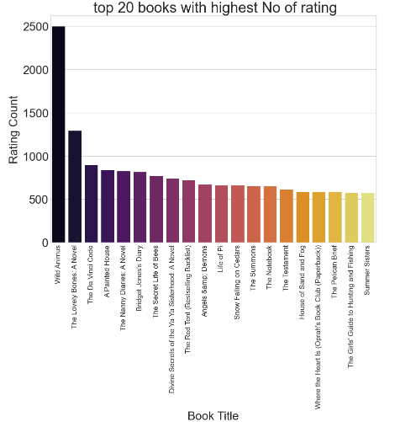
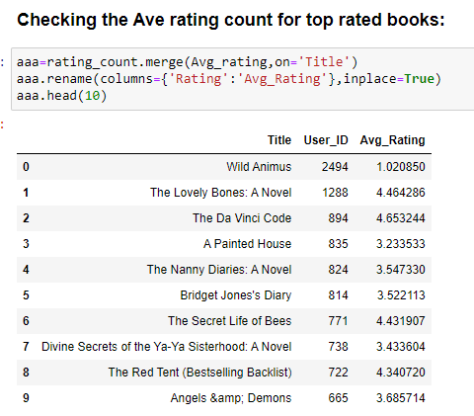
Top 20 books with highest rating count

Slide 18
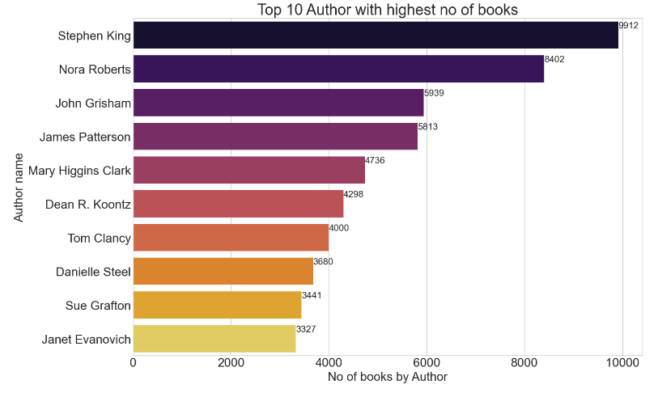
Top 10 authors with highest rating count

Slide 19
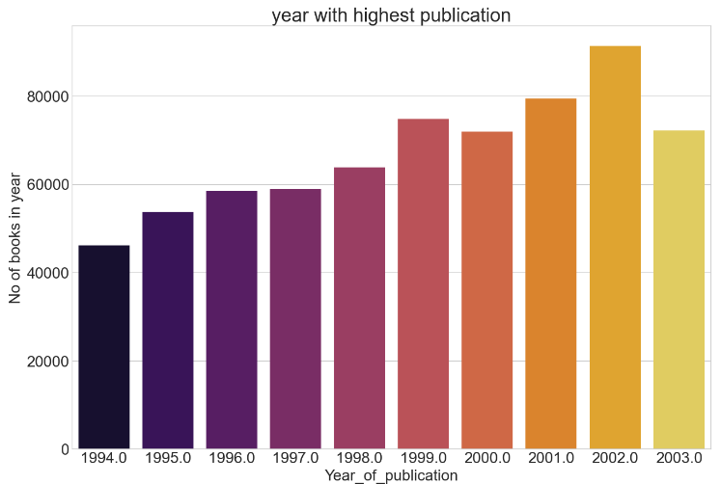
Year vs books published in year

Slide 20
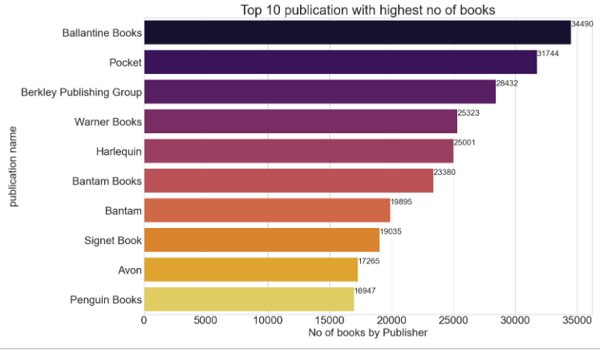
Top 10 books publisher with highest rating count

Slide 21
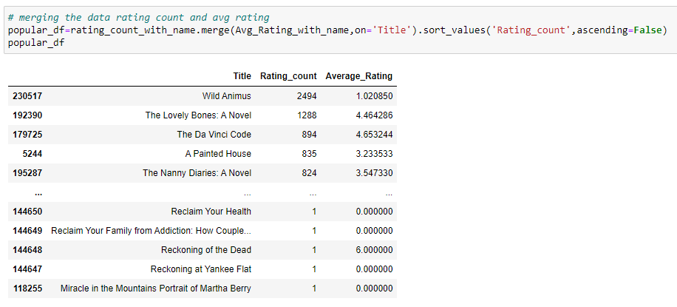
We can see hare that the books having more rating count have low rating also.

Slide 22
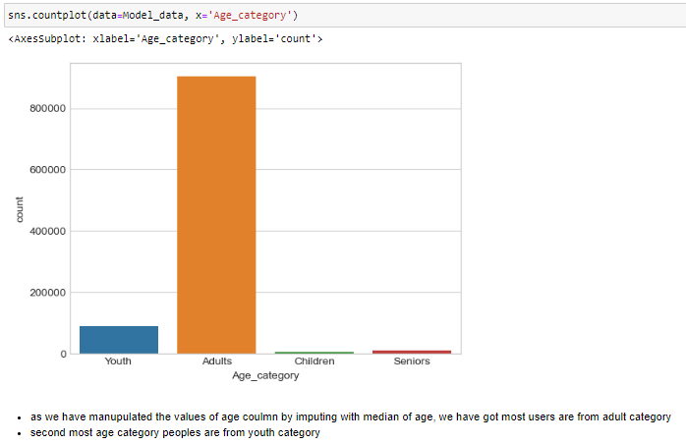
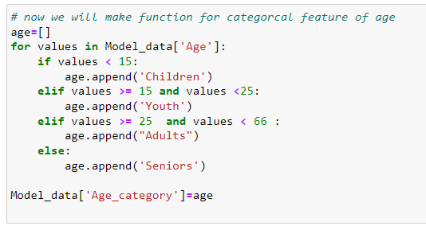
1. Popular Books among the various age category:

Slide 23
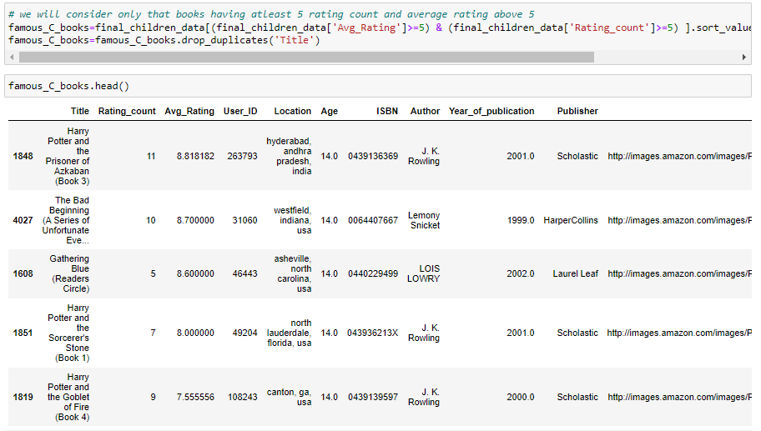
1. Popular Books among the various age category:
1. Popular Books among children:

Slide 24
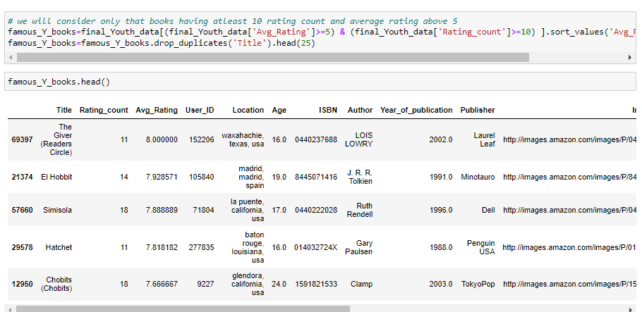
1. Popular Books among the various age category:
1. Popular Books among Youth:

Slide 25
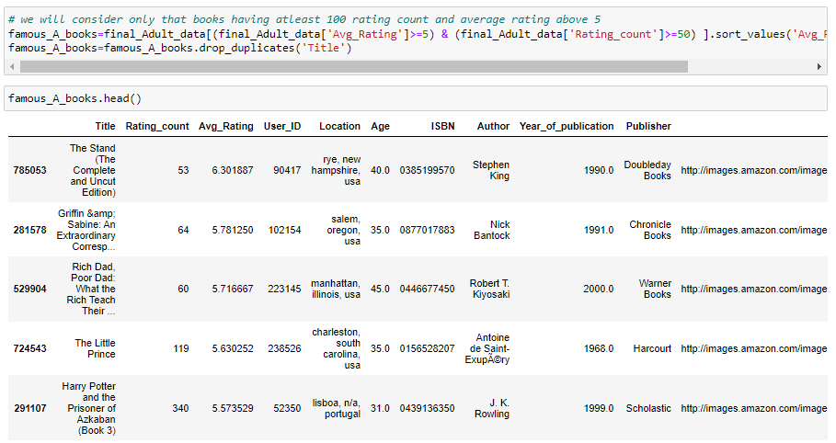
1. Popular Books among the various age category:
1. Popular Books among Adults:

Slide 26
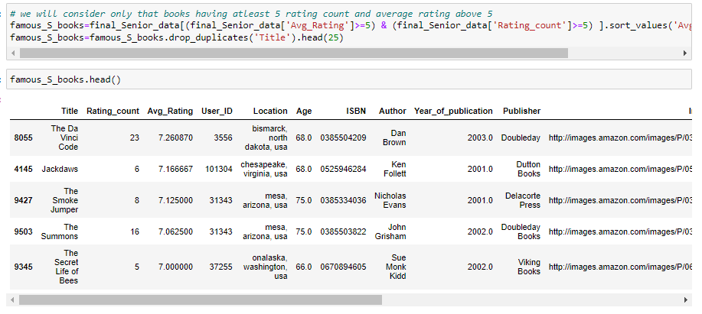
1. Popular Books among the various age category:
1. Popular Books among Senior:

Slide 27
Model building
2. Popularity Based Recommendation System
It is a type of recommendation system which works on the principle of popularity and or anything which is in trend. These systems check about the product or movie which are in trend or are most popular among the users and directly recommend those.
For example, if a product is often purchased by most people then the system will get to know that that product is most popular so for every new user who just signed it, the system will recommend that product to that user also and chances becomes high that the new user will also purchase that.
Merits of popularity based recommendation system
It does not suffer from cold start problems which means on day 1 of the business also it can recommend products on various different filters.
There is no need for the user's historical data.
Demerits of popularity based recommendation system
Not personalized
The system would recommend the same sort of products/movies which are solely based upon popularity to every other user.

Slide 28
Model building
2. Popularity Based Recommendation System
wee will take two criteria for popular books
book with at least have 150 rating count ( this number is randomly chosen for model )
book with highest Avg rating

Slide 29
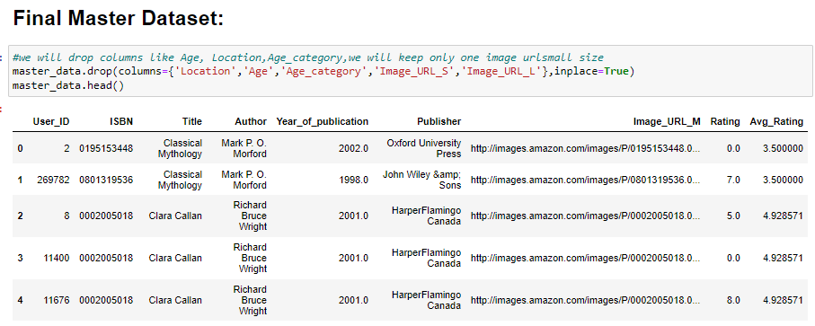
2. Popularity Based Recommendation System

Slide 30
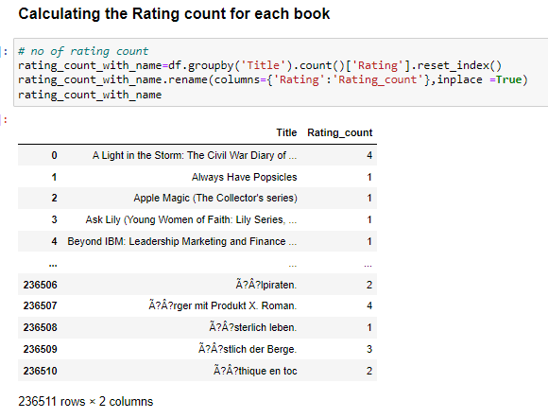
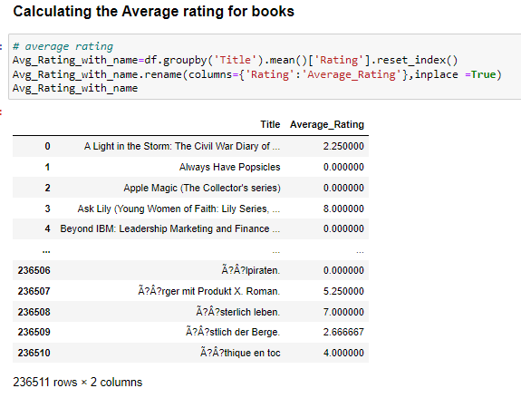
2. Popularity Based Recommendation System

Slide 31
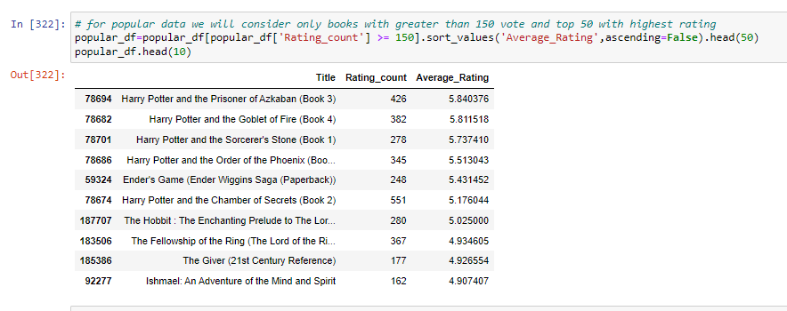
2. Popularity Based Recommendation System
Popular book:

Slide 32
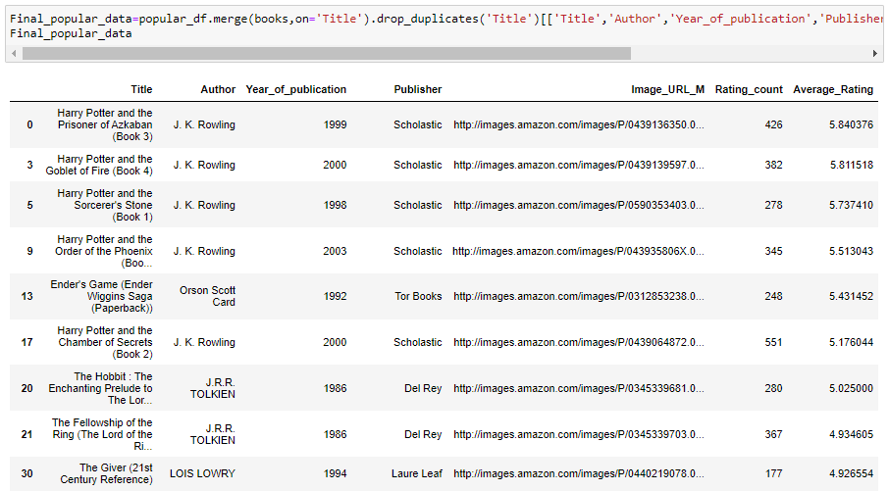
2. Popularity Based Recommendation System

Slide 33
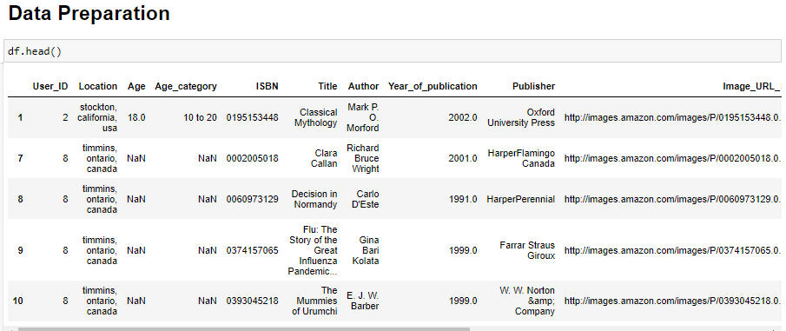
3.1.Collaborative Filtering Based Recommender System

Slide 34
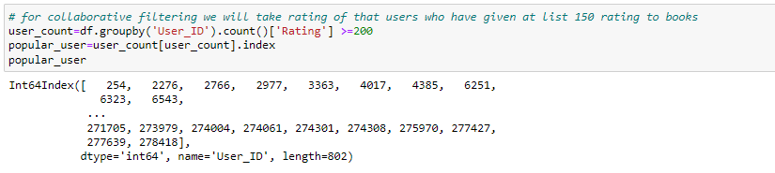
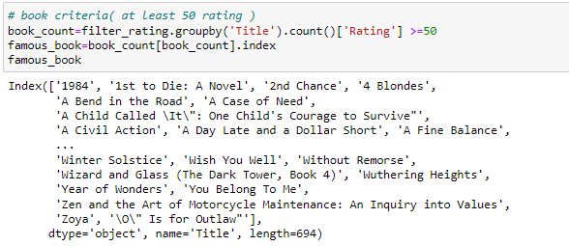
3.1Collaborative Filtering Based Recommender System
User which have rated books more than 200
Book which have more than 50 rating:

Slide 35
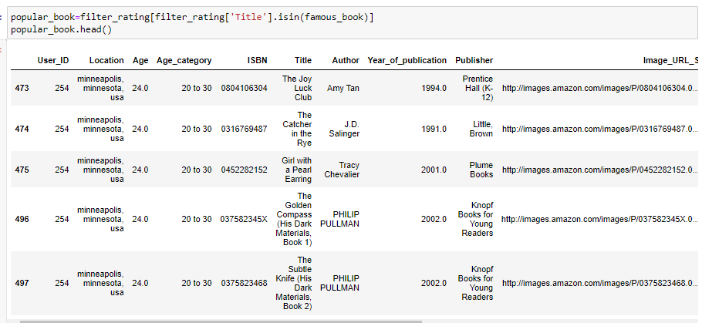
3.1Collaborative Filtering Based Recommender System
Book which have more than 50 rating and rated by popular user:

Slide 36
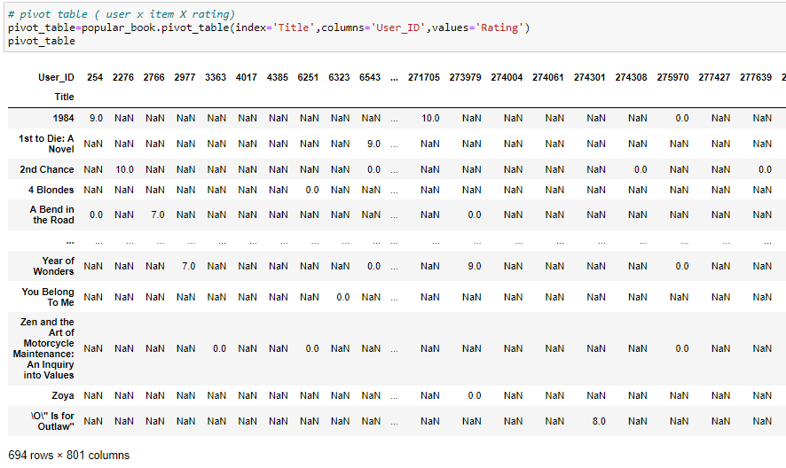
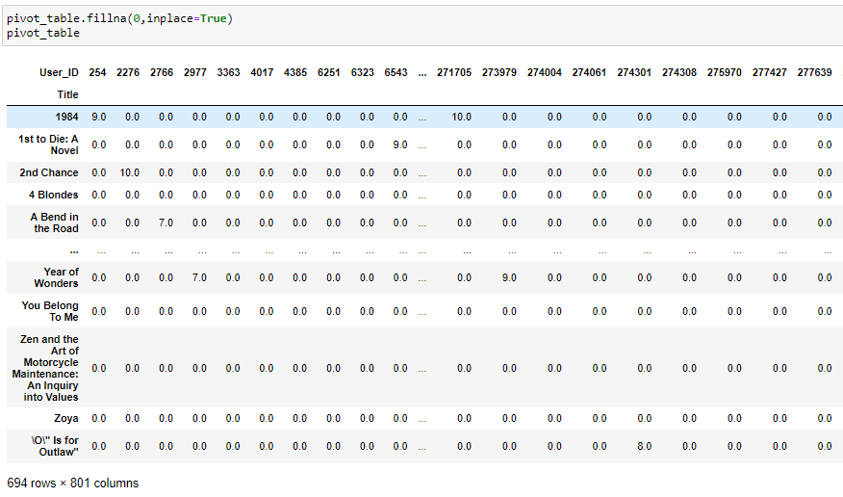
3.1Collaborative Filtering Based Recommender System
Creating the pivot table
Filling null values with 0

Slide 37
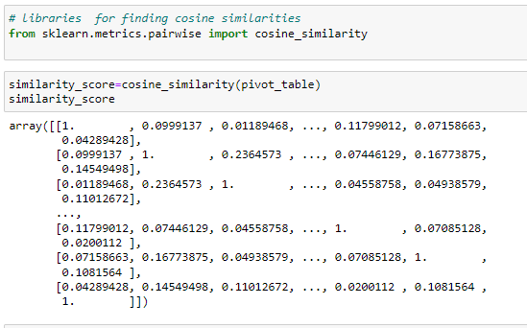
3.1Collaborative Filtering Based Recommender System
Cosine Similarity

Slide 38
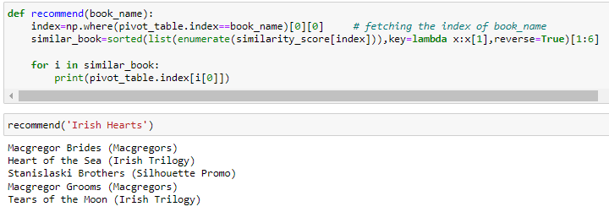
3.1Collaborative Filtering Based Recommender System
Function for recommendation of books:

Slide 39
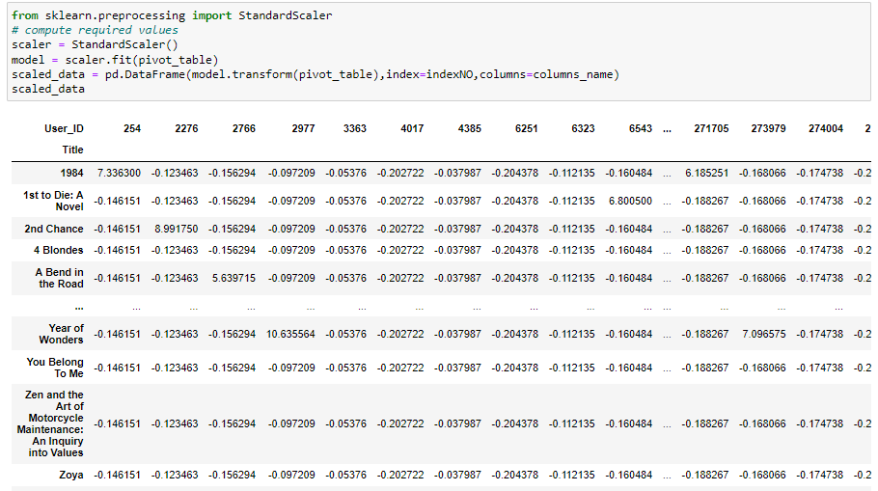
3.2 Collaborative Filtering Based Recommender System
Model 2: Using standard scaler to scale the data

Slide 40
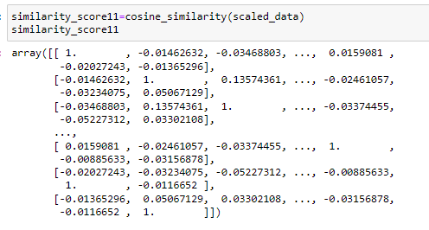
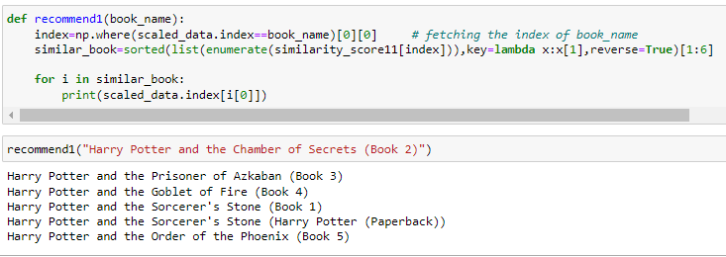
3.2 Collaborative Filtering Based Recommender System
Cosine Similarity

Slide 41
Conclusion:
1.We have build 3 model
1. Popular Books on basis of Age Class
2. Popular Book Recommendation System.
3. Collaborative filtering : item to item
4. Collaborative filtering : item to item ( by standardizing data)
2. We can Recommend the books to new users on basis of popular books
3. We can also recommend books by age wise.
4. In Collaborative filtering model without scaling the data work
recommend more accurate books.

Slide 42
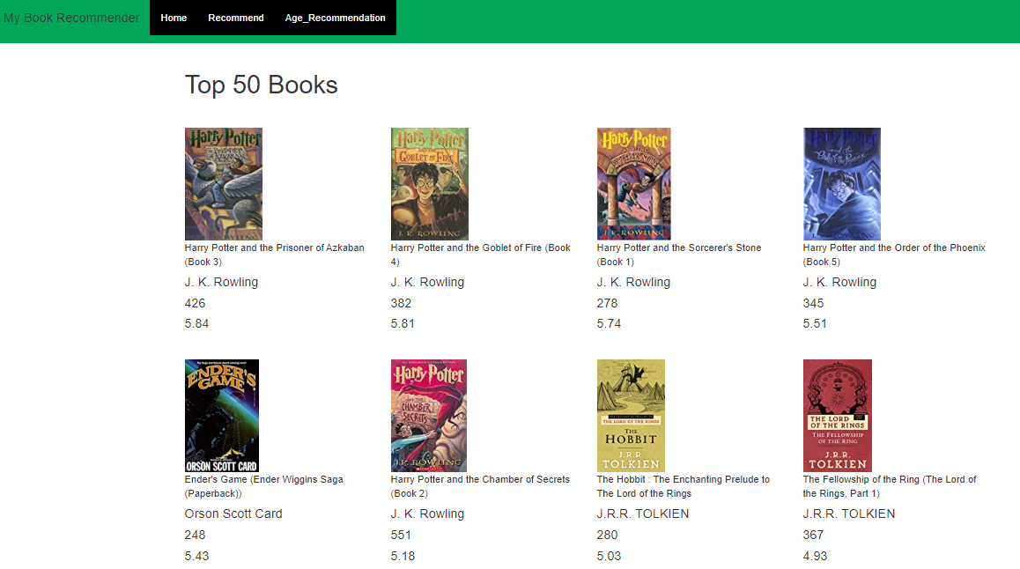
Model deployment using flask api

Slide 43

Model deployment using flask api

Slide 44

Model deployment using flask api

Slide 45
Thank You

